Slide 1
World Wide Web
Lesson A.8

Slide 2
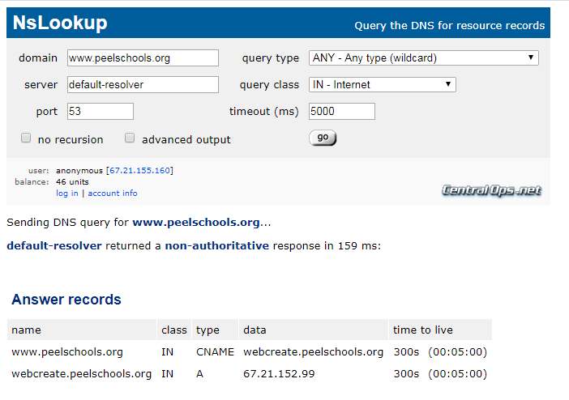
Warm-Up Activity
Goto: https://centralops.net/co/
Use the "NsLookup" Tool
www.peelschools.org
your favorite website
Try some of the other tools

Slide 3
A) Internet Services (Software)
A.1) Client Server Model
What is a Client?
What is a Server?
A.2) Domain Names & IP Addresses
Domain Name Registry
IPv4 and IPv6
A.3) Common Internet Services
DNS (Domain Name Server)
Mail Server
Web Server
File Server
Database Server
Application Servers

Slide 4

A.1) Client-Server Model
A Client Is...
An app that runs on your phone or PC
The app provides the Interface
The app does not control the data
Examples:
A Server Is...
Software that runs on hardware owned by the app company
It sends and receives data between multiple clients using internet connections
They work together to give you the complete application.
One is useless without the other part
Examples: On-Line Games, Spotify, MLB At Bat, etc.

Slide 5
A.2) Domain Names & IP Addresses
A Domain Name is...
An ID for a service on the internet
It is a human readable format
It must be converted to an IP address to be used by a computer
Note: Clients do not have Domain Names
An IP Address is...
The id number of a client or server device on the internet.
It is composed of four numbers
It is used to route messages and data between computers (clients and servers)
Domain Example:
www.peelschools.org
IP Address Example:
67.21.152.99
Note: IP stands for Internet Protocol

Slide 6


A.2) Domain Names & IP Addresses
Who owns names and addresses?
Domain names can be registered by companies and individuals
Government Agencies Control the Registration of Names
myname.ca – CIRA (Canada)
myname.uk – NOMINET (United Kingdom)
com, org, etc. – Network Solutions (United States)
IP Addresses are owned by large Internet Companies
IP Addresses are "rented out" to Domain Names for a fee
With IPv4 there are a limited number of IP Addresses
Domain Name Registry
Companies like GoDaddy.com are middlemen that arrange domain registrations and that provide you with an IP Address
Network Solutions is the company that controls and authorizes registrations for .com domains

Slide 7
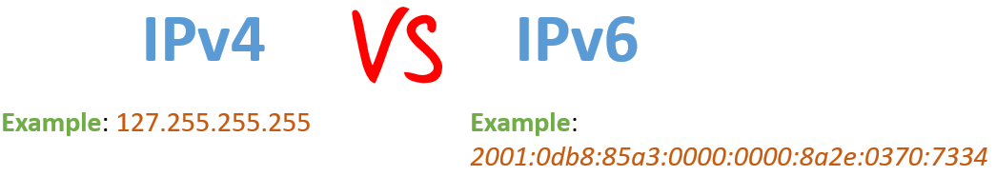
A.2) Domain Names & IP Addresses
IPv4 (1990 to Present)
4 numbers, 64 bits (2^64 combinations)
Issues: Limited Speed & Limited Number of Connections
IPv6 (Near Future)
8 alpha –numerics, 128 bits (2^128 combinations)
Advantages: Higher Speed & Unlimited Number of Connections
5G Networks (Coming Soon)
Leverages IPv6 technology to provide extreme speeds
Every device (e.g. doorbell) will have its own IP address

Slide 8
A.3) Common Internet Services
DNS (Domain Name Server)
Web Server
HTTP protocol
Mail Server
File Server
Database Server
Application Servers

Slide 9
A.3) Common Internet Services
DNS (Domain Name Server)
Web Server
HTTP protocol
Mail Server
File Server
Database Server
Application Servers

Slide 10
B) Internet Servers (Hardware)
Firewall, Lan, Wan
VPN
RAID

